Slide 1
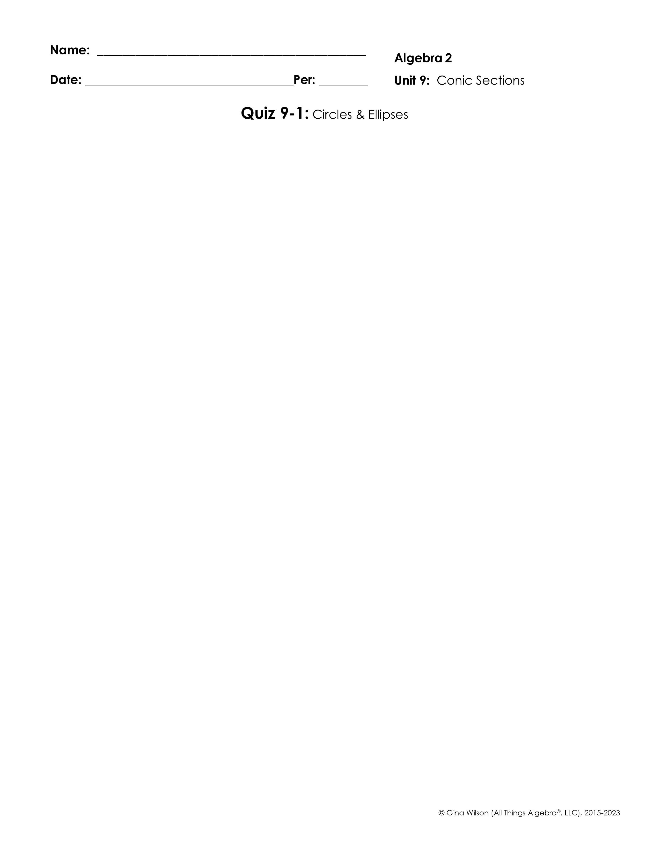
Graph each circle. Identify the center and radius.
1.
2.
Center: ____________ Radius: ____________
Center: ____________ Radius: ____________
Write the equation of the circle in standard form. Identify the center and radius.
3.
4.
Standard Form: ____________________________
Center: _______________; Radius: ___________
Standard Form: ____________________________
Center: _______________; Radius: ___________
Write the equation of the circle in standard form with the given characteristics.
5. Center: (-7, -2); Radius: 9
6. Center: (4, 0); Radius:
Standard Form: _________________________________
Standard Form: _________________________________
7. Center: (5, 9); Point on Circle: (7, 8)
8. Endpoints of Diameter: (-5, -8) and (7, 2)
Standard Form: _________________________________
Standard Form: _________________________________

Slide 2

Graph each ellipse. Identify the center, vertices, co-vertices, and foci.
9.
10.
Center _________________
Vertices: _______________________________________ Co-Vertices: ____________________________________
Foci: ___________________________________________
Center _________________
Vertices: _______________________________________ Co-Vertices: ____________________________________
Foci: ___________________________________________
Write the equation of the ellipse in standard form. Identify all characteristics.
11.
12.
Standard Form: ___________________________________
Center _________________
Vertices: ________________________________________ Co-Vertices: _____________________________________
Foci: ____________________________________________
Standard Form: ___________________________________
Center _________________
Vertices: ________________________________________ Co-Vertices: _____________________________________
Foci: ____________________________________________
Write the equation of the ellipse in standard form with the given characteristics.
13. Vertices: (2, 1) and (2, 7)
Co-Vertices: (0, 4) and (4, 4)
14. Vertices: (-3, 4) and (5, 4) Foci: (-1, 4) and (3, 4)
Standard Form: _____________________________________

